Slide 1

Predictive Disease Diagnosis System for Heart Disease and Diabetes
Student Guided Project
Machine Learning Application in Healthcare

Slide 2
Introduction
The Challenge
Why ML Matters
Heart disease and diabetes are among the leading causes of mortality worldwide. Early detection remains challenging due to:
Machine learning enables automated analysis of patient data, identifying complex patterns that may escape human observation. This system aims to:
Subtle early symptoms that often go unnoticed
Delayed diagnosis leading to complications
Limited accessibility to specialized healthcare
Need for rapid, accurate screening tools
Process multiple health indicators simultaneously
Provide immediate risk assessment
Assist healthcare professionals with data-driven insights
Improve patient outcomes through early intervention

Slide 3

Project Objectives
Accurate Prediction
Early Diagnosis
Develop ML models to predict heart disease and diabetes with high accuracy using clinical patient data
Improve early detection rates by identifying at-risk patients before symptoms become severe
System Implementation
Model Validation
Build a user-friendly, automated prediction system accessible to healthcare providers
Compare multiple ML algorithms and validate performance using standard metrics

Slide 4
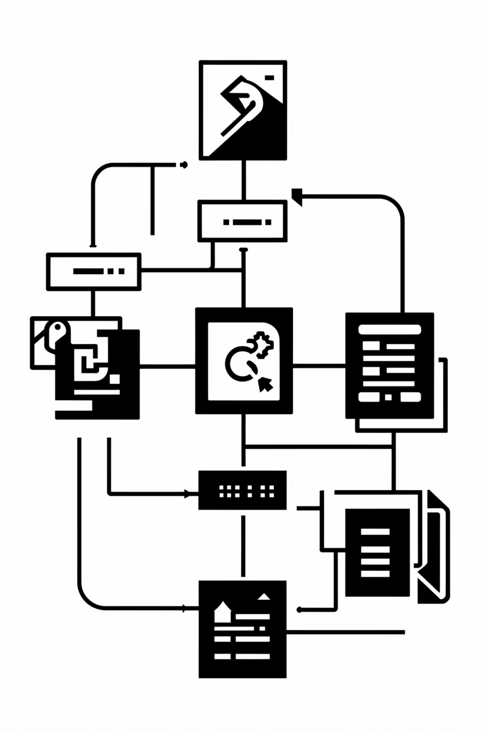
Data Preprocessing Pipeline
01
Missing Value Treatment
Identified and handled missing data points using statistical imputation methods
02
Outlier Detection
Removed or corrected anomalous values that could skew model predictions
03
Feature Scaling
Standardized numerical features to ensure equal weight in model training
04
Encoding Categorical Variables
Converted categorical data into numerical format for ML algorithm compatibility

Slide 5
Machine Learning Models
Six supervised learning algorithms were implemented and evaluated for disease prediction:
Aspect
Logistic Regression
Random Forest
Interpretability
High
Medium
Handles non-linearity
No
Yes
Accuracy
Moderate
High
Medical trust
High
Medium
Logistic Regression
Random Forest
Statistical method for binary classification, interpretable coefficients for feature importance
Ensemble of decision trees, reduces overfitting while improving accuracy

Slide 6
Model Training & Evaluation Methodology
Training Process
Evaluation Metrics
Dataset was split into training (80%) and testing (20%) sets. Models were trained using k-fold cross-validation to ensure robust performance assessment across different data subsets.
Accuracy: Overall correctness of predictions
Recall: Ability to identify actual disease cases
Confusion Matrix: Detailed breakdown of true/false positives and negatives
Hyperparameter tuning was performed using grid search to optimize each algorithm's parameters for maximum predictive power.

Slide 7

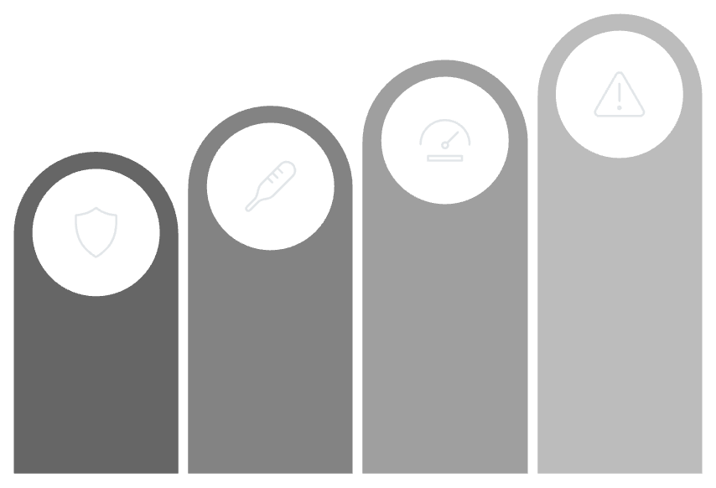
Prediction Thresholds in Detail
Understanding prediction thresholds is critical for clinical decision-making, as they directly impact the balance between identifying true disease cases and avoiding false alarms. The optimal threshold can vary significantly based on the specific disease and the consequences of misclassification.
Heart Disease: Logistic Regression Threshold
Diabetes: Random Forest Threshold
1.0
High Risk
Threshold
Heart Disease Present
Low Risk
No Risk
0.5 Cutoff
No Heart Disease
Random Forest, while highly accurate, aggregates predictions from many decision trees. The final threshold for diabetes risk is not a fixed 0.5 but is calibrated based on cross-validation results to optimize performance metrics, especially recall, to minimize missed diagnoses. This adaptive threshold helps in robust identification of diabetes cases across varied patient profiles.
0.0
For heart disease prediction, Logistic Regression provides a probability score between 0 and 1. An initial threshold of 0.5 was set, meaning any patient with a predicted probability of 50% or higher is flagged as having heart disease. This threshold can be adjusted based on the desired sensitivity and specificity for early detection.

Slide 8
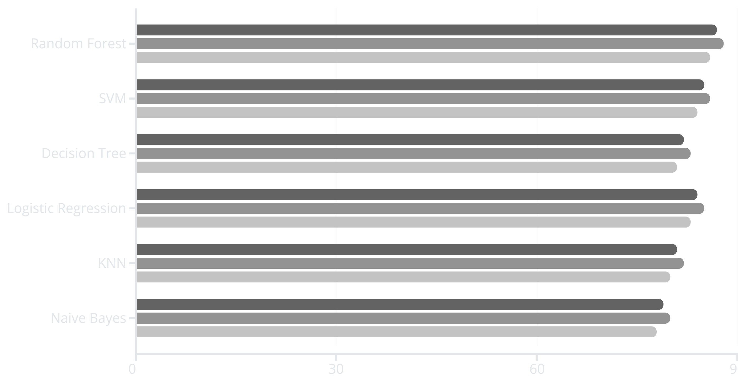
Performance Comparison
Accuracy (%)
Precision (%)
Recall (%)
Key Finding: Random Forest achieved the highest accuracy (87%) with balanced precision and recall, demonstrating robust generalization to unseen patient data.

Slide 9
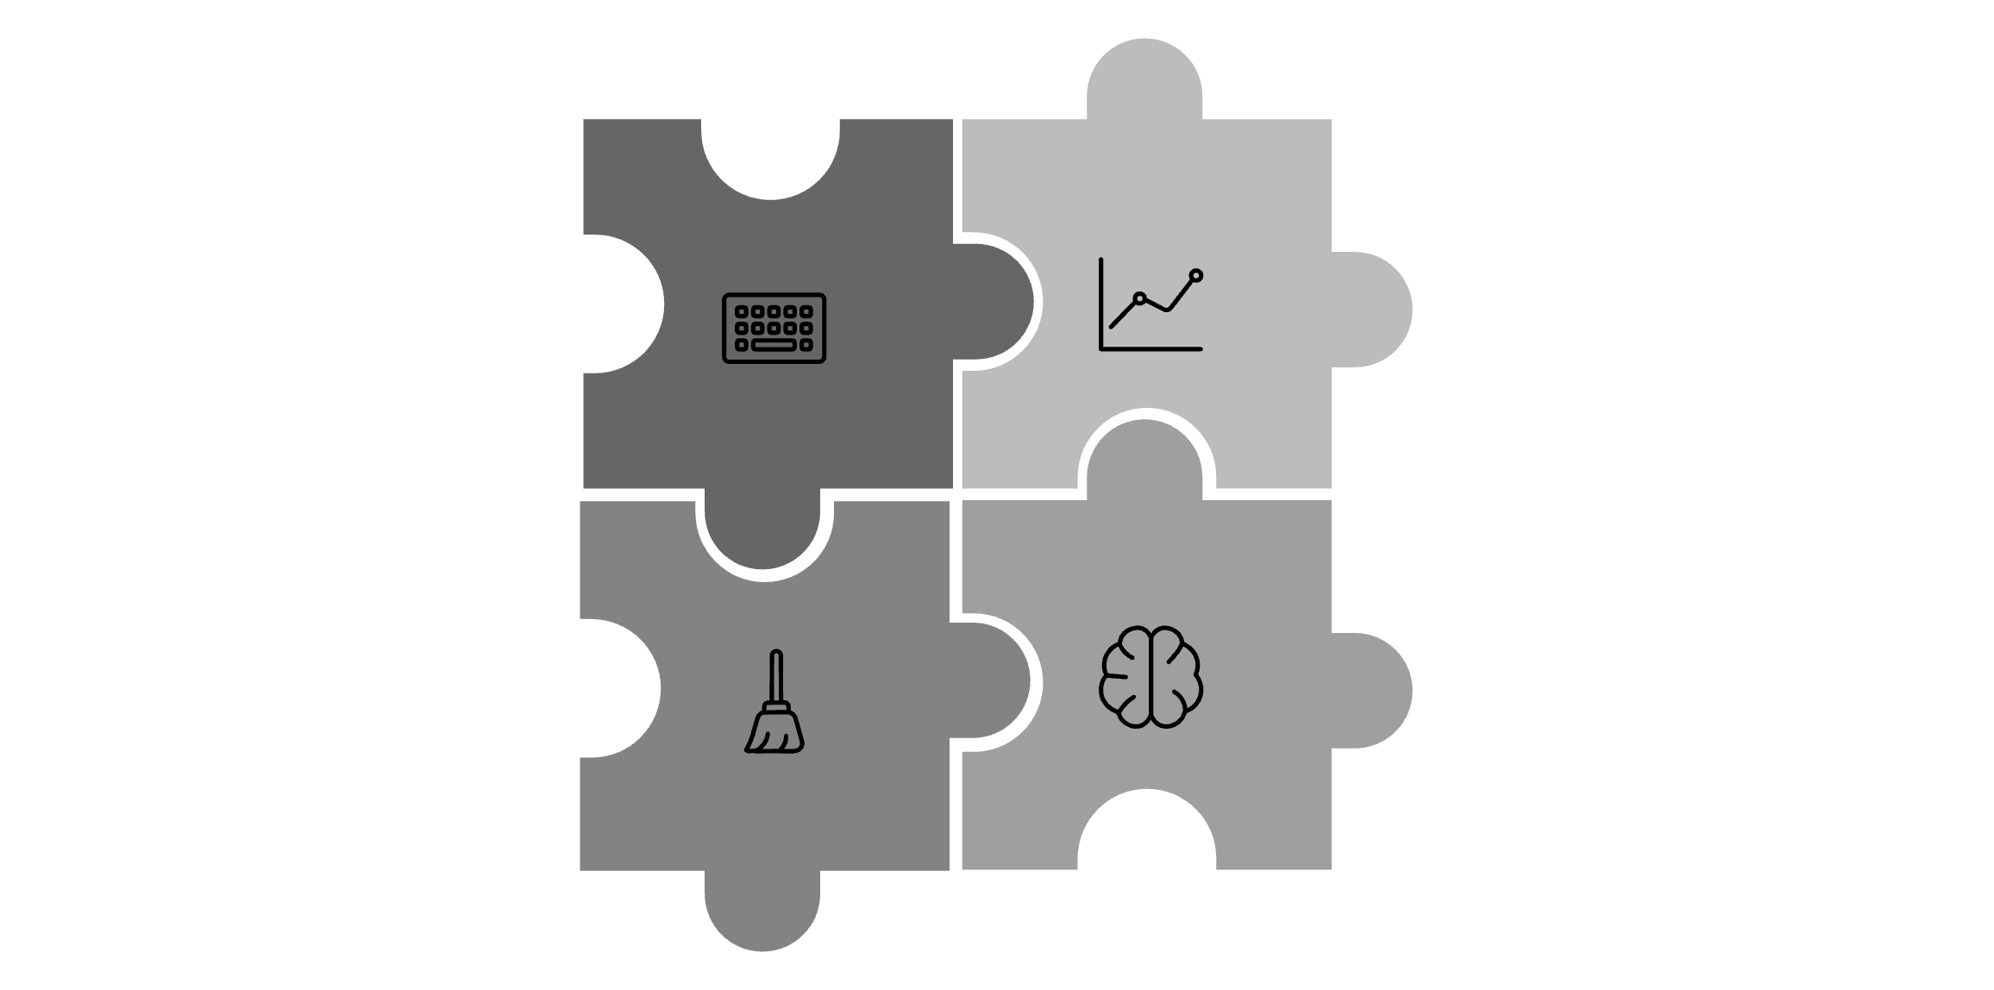




System Architecture
Data Input
Prediction Output
Preprocessing
ML Model
Data Input
Preprocessing
Patient health parameters entered via interface
Data cleaning, scaling, and validation
ML Model
Prediction Output
Trained algorithm processes features
Risk probability and diagnosis

Slide 10
Conclusion & Future Scope
Key Achievements
Future Enhancements
The system successfully demonstrated the feasibility of ML for disease prediction with Random Forest achieving 87% accuracy. The framework provides healthcare professionals with a reliable screening tool for early intervention.
Real-time integration: Connect with electronic health records for automated data retrieval
Deep learning: Implement neural networks for improved pattern recognition
Mobile application: Develop patient-facing app for self-assessment
Expanded scope: Include additional diseases and health conditions
Clinical validation: Partner with hospitals for real-world testing
Benefits include:
Rapid assessment of patient disease risk
Data-driven clinical decision support
Reduced diagnostic errors
Scalable solution for population health

